Slide 1

Week 11 Presentation
Wednesday, November 6, 2019
Notes:
Welcome to our week 9 presentation. We are ATLAS Data Mining team. [self intro based on the list, name, major, title] The objective of this project is to study what impacts students’ matriculation from a financial perspectives.

Slide 2



The SMMC Data Mining Team -
Smruthi Iyengar
Kagen Quiballo
Hanqing Wang
Yuxin Wang
Notes:
Take a look at loans only - 70% graduate with loans. Of those that don’t continue, how many have loans

Slide 3
Presentation Overview
1. Funding method impact on matriculation
2. Certain Colleges more likely to have holds
3. Having Authorized payer affect likelihood of having a hold
4. Relationship between late fee and holds
Notes:
Does funding method (methods of payment/financial aid) impact enrollment in a subsequent term？
Are students from a specific college or degree program more or less likely to receive a financial hold？
explore how would late fee incurred be used to predict holds

Slide 4
Does funding method (methods of payment/financial aid) impact enrollment in a subsequent term (matriculation)?
matri_F_A :
1 if student matriculated from F17 to S18, 0 if didn’t continue or withdrew
Look at different ratios based on Total Account Charges:
Self Help Ratio (Loans)
Gift Aid Ratio (Scholarships, Grants, Awards)
Payment Ratio (Payment Plan, Credit Card, eCheck)

Slide 5
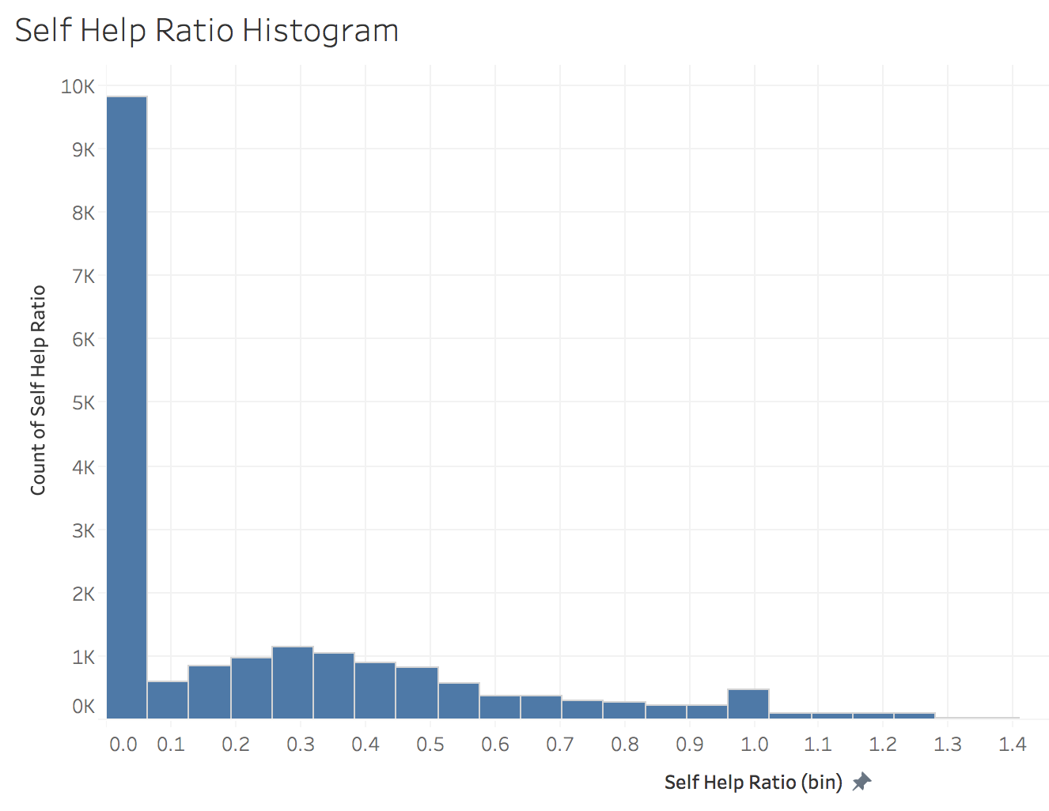
self help ratio = 0
(9,831 students)
50.5% receive no self help
10.8% withdraw
89.2% continue
self help ratio =/= 0
(9,623 students)
7.9% withdraw
92.1% continue

Slide 6
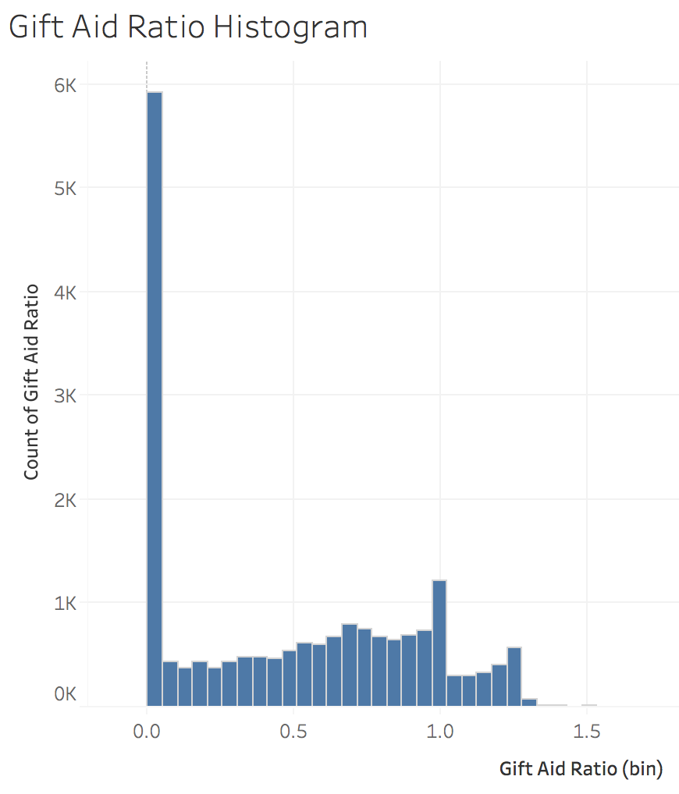
gift aid ratio = 0
(5,923 students)
30.4% receive no self help
12.2% withdraw
87.8% continue
gift aid ratio =/= 0
(13,531 students)
8.1% withdraw
91.9% continue

Slide 7
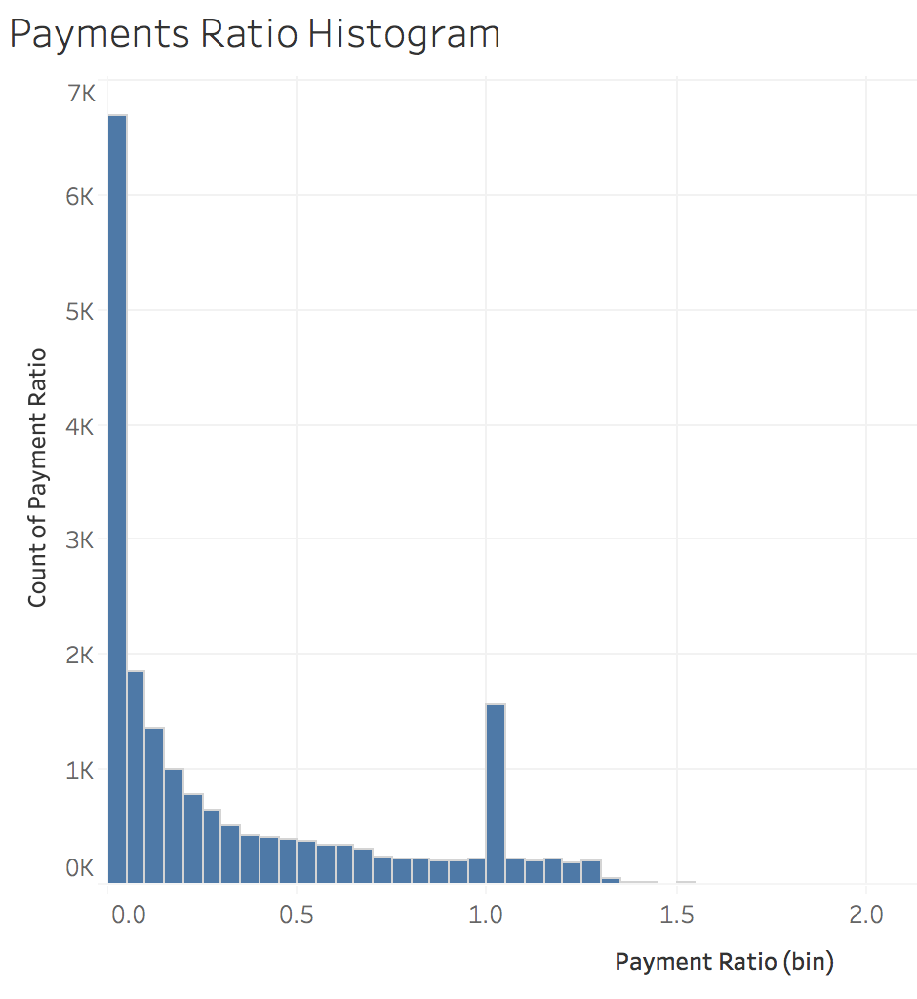
payments ratio = 0
(6,700 students)
34.4% receive no self help
8.7% withdraw
91.3% continue
payments ratio =/= 0
(12,754 students)
9.7% withdraw
90.3% continue

Slide 8
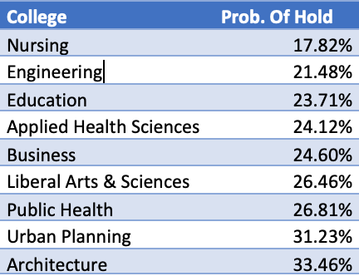
Does College Impact Holds?
Probability of all students receiving a hold
About 24%
Nursing least likely to have a hold
Architecture most likely to have a hold
Only two colleges that are significantly different

Slide 9

Does Authorized Payer Impact Hold
No, not statistically different although there is a small difference

Slide 10
LATE FEE VS. HOLD
Late fee:
incurred in Sept & Oct 2017: 1
Not incurred : 0
Predict
Holds:
Oct & Nov & Dec 2017: 1
No holds : 0
Accuracy | 0.88
Precision | 0.78

Slide 11
Conclusion
There’s certain time’s late fee that can be used to predict the future hold.
Students from Nursing are less likely to have a hold. Students from Architecture are more likely to have a hold.
Students who accept financial aid have lower dropout rates than those who are not offered any financial aid
Students who have to pay out of pocket have higher dropout rates than those who do not have to
Having an Authorized Payer does not affect hold rates

Slide 12

THANK YOU FOR LISTENING
QUESTIONS?

